Slide 1
Introduction to Free Prior Informed Consent in Law and Policy
By Russell Diabo
NAFA National Meeting on FPIC
December 3, 2014 Saskatoon, Saskatchewan

Slide 2
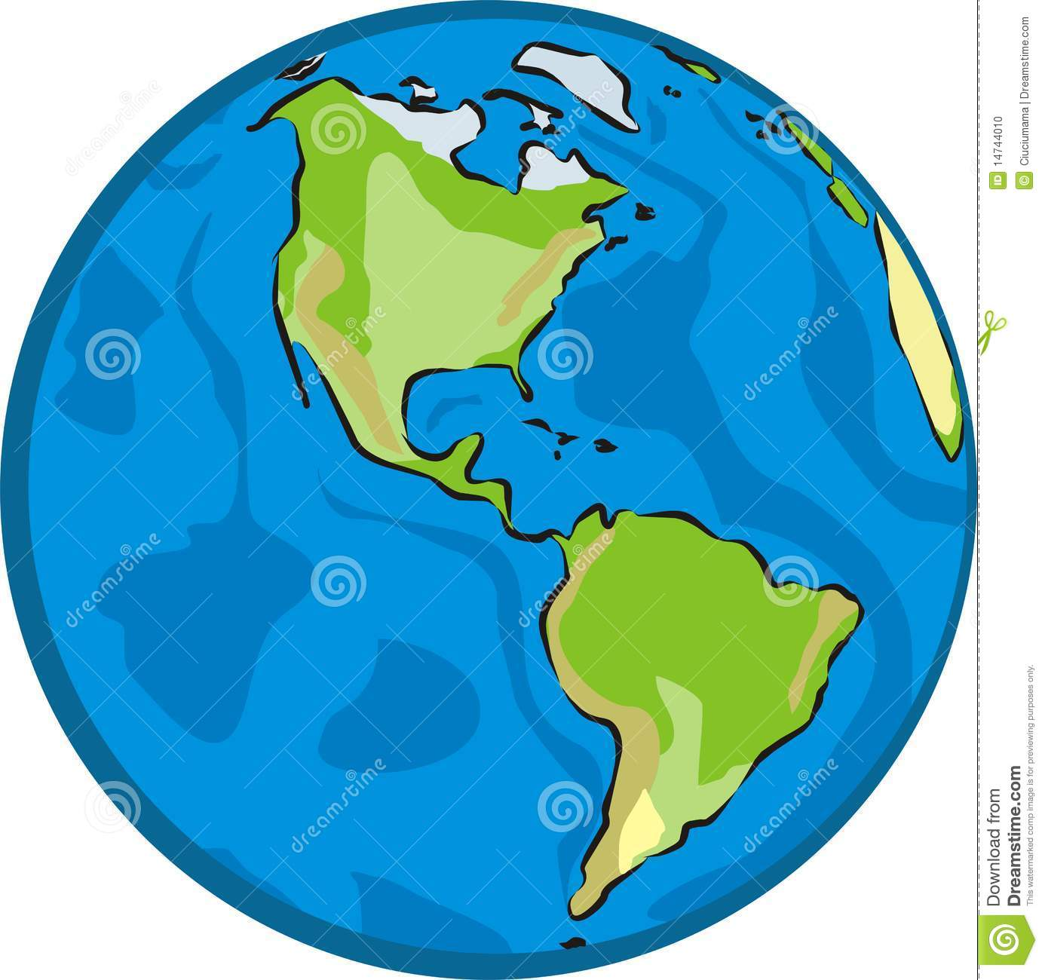
Western Hemisphere

Slide 3
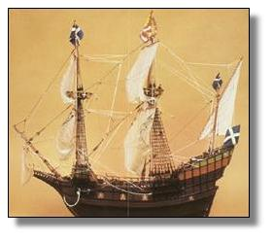
European Contact & Change

Slide 4
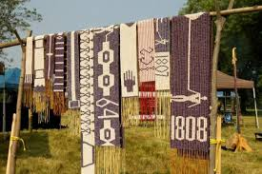
Early Peace & Friendship Treaties
The Doctrine of Consent

Slide 5
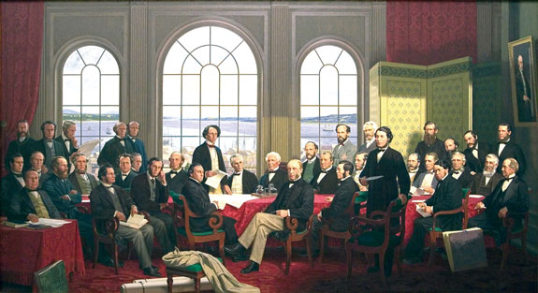
FATHERS OF CONFEDERATION
First legislative Assembly July 1, 1867

Slide 6
Federal Powers – Section 91
Public Debt and Property
Regulation of Trade/Commerce
Direct/Indirect Taxation
Defence
Navigation/Shipping
Sea Coast and Inland Fisheries
Ferries (interprovincial/ international)
Currency, Banking /Incorporation of Banks/Paper Money
Bankruptcy
Patents, Copyrights
Indians & lands reserved for the Indians
Citizenship, Marriage/Divorce
Criminal law, including Criminal Procedure

Slide 7
Provincial Powers – Section 92
Direct Taxation within Province
Management/Sale of Public Lands belonging to Province
Prisons, Hospitals
Municipalities
Formalization of Marriage
Property and Civil Rights
Administration of Civil/Criminal Justice
Education
Incorporation of Companies
Natural Resources
Matters of a merely local or private nature

Slide 8
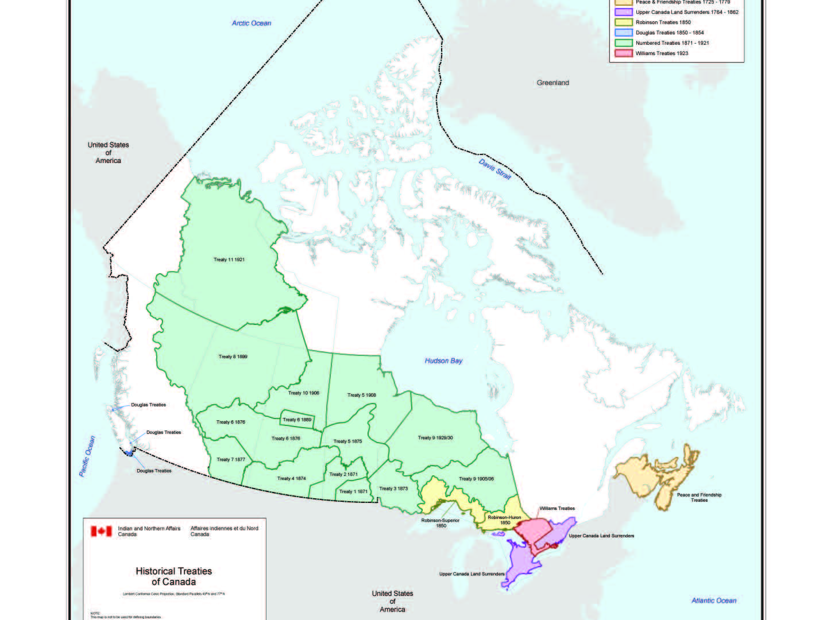

Slide 9
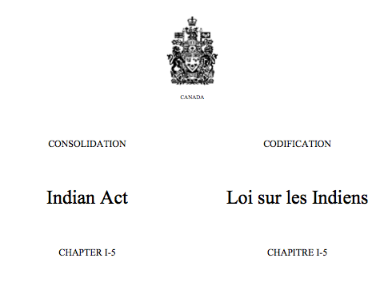
INDIAN ACT

Slide 10
Indian Act
The Indian Act has conflicting and parallel objectives:
the protection of Indians and their lands on the one hand,
and the control, assimilation and civilization of Indian peoples on the other.

Slide 11
Indian Act
In 1951, a revised Indian Act was adopted by Parliament. In most respects it was the same as the 1876 Act. The protective obligations of the Crown were seen only as a temporary duty which would disappear once complete assimilation had been achieved.

Slide 12
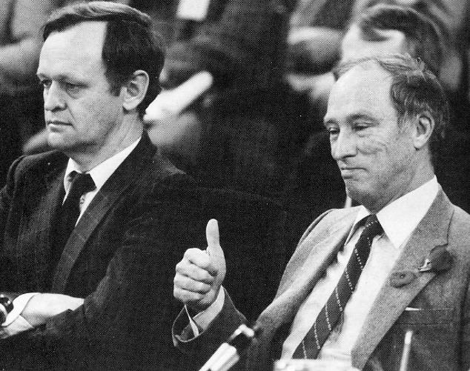
Chrétien and Trudeau

Slide 13
Indian Act Consultations
Between 1968 and 1969, Canada once again took another look at Indian policy, in light of Prime Minister Pierre Elliot Trudeau’s vision of individual equality for all Canadians and the dismantling of collective rights. As in the 1940's and 50's, extensive consultations were carried out, which were duly ignored by officials. The result was the release of the White Paper in 1969.

Slide 14
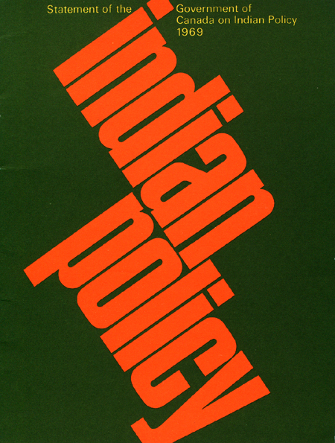
1969 WHITE PAPER ON INDIAN POLICY

Slide 15
1969 White Paper Proposals
Eliminate Indian Status.
Dissolve the Department of Indian Affairs within 5 years.
Abolish the Indian Act & remove section 91.24.
Convert reserve land to private property that can be sold by the band or its members.
Transfer responsibility for Indian Affairs from the federal government to the province and integrate these services into those provided to other Canadian citizens.
Provide funding for economic development.
Appoint a commissioner to address outstanding land claims and gradually terminate existing Treaties.

Slide 16
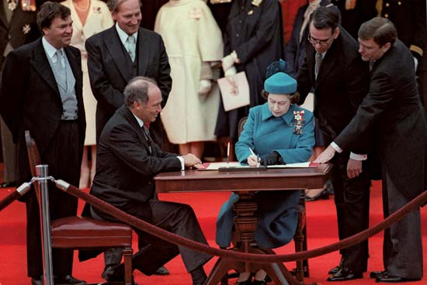
CONSTITUTION ACT 1982

Slide 17
Constitution Act 1982
On April 17, 1982, the Constitution Act 1982 became law.
Section 35 of the new constitution “recognizes and affirms the existing aboriginal and treaty rights of aboriginal peoples”.
A series of First Ministers’ Conferences were held in 1983, 1984, 1985 and 1987, to identify & define the scope and content of sec. 35, but these constitutional conferences ended in failure.

Slide 18
1983 Amended Section 35
35. (1) The existing aboriginal and treaty rights of the aboriginal peoples of Canada are hereby recognized and affirmed.
(2) In this Act, "aboriginal peoples of Canada" includes the Indian, Inuit and Métis peoples of Canada.
(3) For greater certainty, in subsection (1) "treaty rights" includes rights that now exist by way of land claims agreements or may be so acquired.
(4) Notwithstanding any other provision of this Act, the aboriginal and treaty rights referred to in subsection (1) are guaranteed equally to male and female persons.

Slide 19
Proposed Distinct Order of Indigenous Government
Federal Powers
Section 91
First Nations Powers
Section 35
Provincial Powers
Section 92

Slide 20
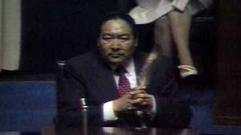
END OF MEECH LAKE ACCORD 1990

Slide 21
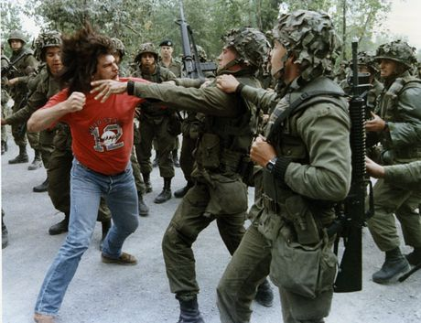
1990 ARMY IN KAHNAWAKE

Slide 22
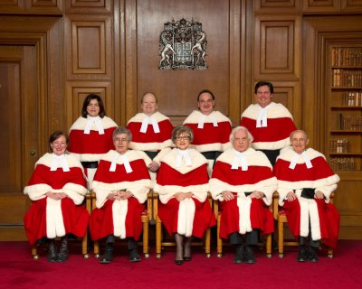
Supreme Court of Canada:
The Judges

Slide 23
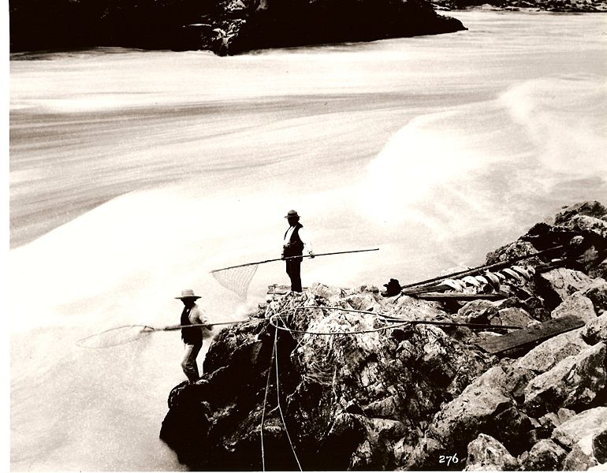
SCC Aboriginal Rights Test

Slide 24
R. v Van Der Peet (1996)
The right must involve an activity that was a “practice, tradition or custom [that] was a central and significant part of the [Aboriginal] society’s distinctive nature.
The activity must have existed prior to contact with European settlers.
The activity, even if evolved into modern forms, must be one that continued to exist after 1982, when the Constitution Act was passed.

Slide 25
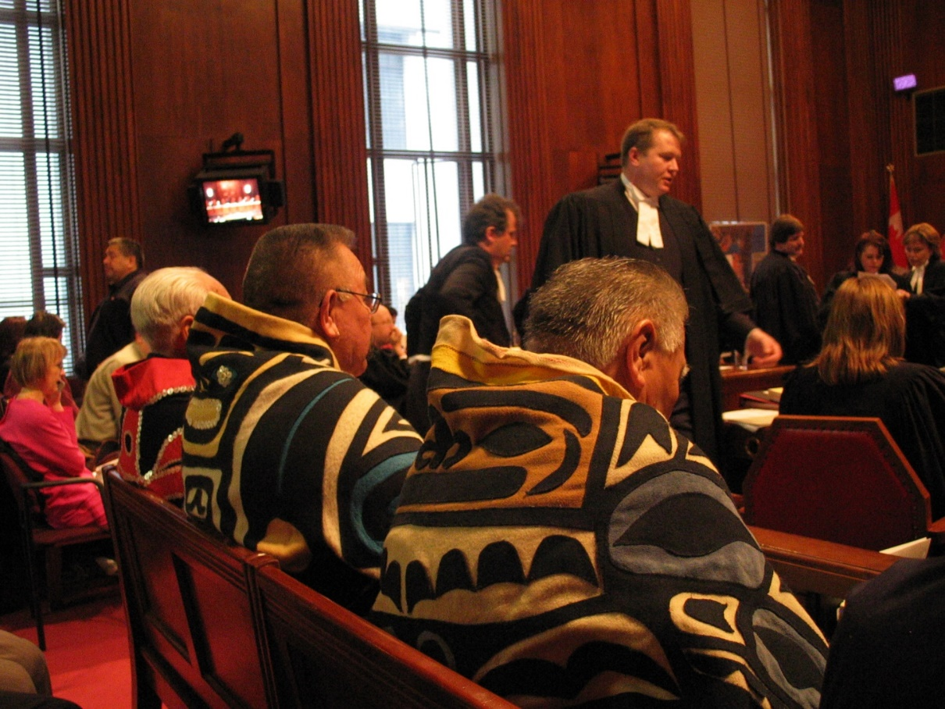
Haida at Supreme Court of Canada

Slide 26
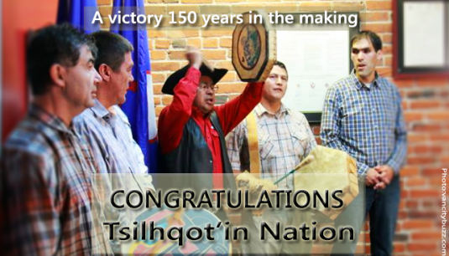
SCC Tsilhqot’in Decision

Slide 27
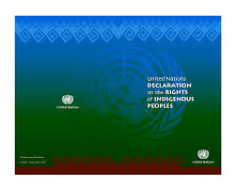
United Nations Declaration on the Rights of Indigenous Peoples

Slide 28
Selected Articles of UNDRIP
Article 3 – Right to Self-Determination.
Article 10 – No forced removal w/o FPIC.
Article 19 – FPIC required before legislation/administration measures.
Article 26 – Rights to lands, territories, resources.
Article 27 – Fair process jointly developed to adjudicate rights to lands, territories, resources.
Article 32 – FPIC required for and development affecting lands, territories, resources.
Article 37 – Rights from Treaties, agreements, constructive arrangements.

Slide 29
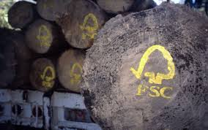
Forest Stewardship Council

Slide 30
Background to Forest Stewardship Council
Concerns about deforestation, environmental degradation and social exclusion, various groups met in California in 1990.
The concept of FSC and the name were coined at this meeting.
In 1992, the United Nations Conference on Environment and Development – the Earth Summit – was held in Rio de Janeiro in 1992.
The Earth Summit produced no legally binding commitments on forest management, but it did result in Agenda 21 and the non-legally binding Forest Principles.
At the Earth Summit support grew for the idea of a non-governmental, independent and international forest certification scheme.

Slide 31
Background to Forest Stewardship Council
Following consultations in ten countries to build support for the idea of a worldwide certification system, the FSC Founding Assembly was held in Toronto, Canada in 1993.
The FSC Secretariat opened in Oaxaca, Mexico and the FSC was established as a legal entity in Mexico in February 1994. The FSC Secretariat relocated to Bonn, Germany in 2003.
FSC Canada was created in 1996, during a meeting in Toronto with four Chambers.
FSC Canada has developed four Regional Standards.
FSC Canada is in the process of harmonizing into one national standard using FSC’s International Generic Indicators (IGI’s).

Slide 32
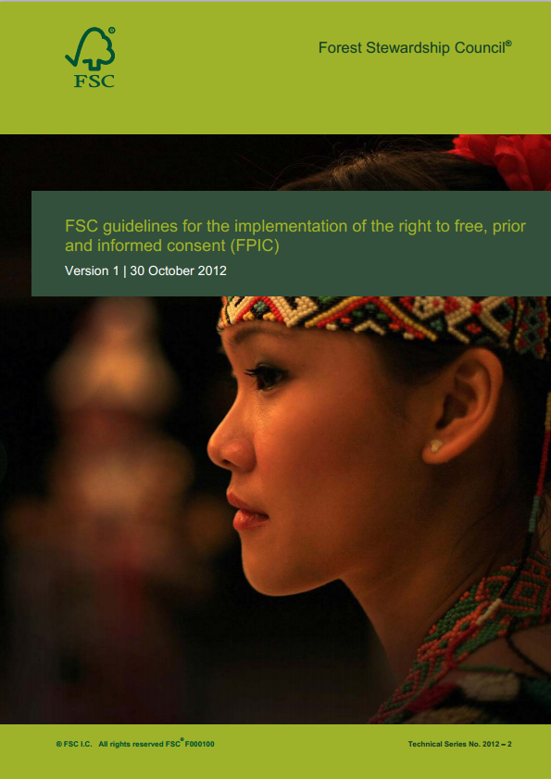
FSC and FPIC

Slide 33
Key FSC Principles and FPIC
Principle 1: Compliance with laws and FSC Principles – to comply with all laws, regulations, treaties, conventions and agreements, together with all FSC Principles and Criteria.
Principle 2: Tenure and use rights and responsibilities – to define, document and legally establish long-term tenure and use rights.
Principle 3: Indigenous peoples’ rights – to identify and uphold indigenous peoples’ rights of ownership and use of land and resources.
Principle 4: Community relations and worker's rights – to maintain or enhance forest workers' and local communities’ social and economic well-being.

Slide 34
FSC Principle 1 vs. Principle 3
In Canada, the voluntary FSC Principles & Criteria have been overtaken by the evolution of section 35 constitutional framework on Aboriginal Rights, Title & Treaties.
The federal (and provincial) policy framework for addressing section 35 Aboriginal Rights, Title & Treaties are increasingly inconsistent with SCC decisions, such as Haida, Tsilhqot’in and Grassy Narrows.
SCC Haida, Tsilhqot’in & Grassy Narrows decisions all involved forest management issues.
Although Canada supported UNDRIP in Nov. 2010, they backed away from FPIC in Explanation of Vote at Sept. 2014, UN HLP.

Slide 35
Conclusion
In Canada, the Doctrine of Indigenous Consent was established early on in the relations between Indigenous Nations and Europeans. In modern times this equates to the Indigenous People’s Right of Self-Determination.
The SCC through recent case law has laid out a section 35 framework for reconciling pre-existing Rights, Title & Treaties. However the costs of meeting the legal tests and sustaining court actions will likely be prohibitive for most Indigenous People’s.
The challenge for FSC will be to manage/maintain certification in the face of growing gaps between the direction of the SCC and the forest acts, policies & practices of the provinces/territories in denying and avoiding Aboriginal Rights, Title & Treaties.

